Slide 1
Trees
Binary and General Trees

Slide 2
Balanced Binary Trees
Balanced binary tree
  The height of any node’s right subtree differs from the height of the node’s left-subtree by no more than 1.
  A complete binary tree is balanced.

Slide 3
Represent a complete Binary Tree
i | A(i) | Left(i) | Right(i)
1 | Jane | 2 | 3
2 | Bob | 4 | 5
3 | Tom | 6 | 7
4 | Alan | -1 | -1
5 | Ellen | -1 | -1
6 | Nancy | -1 | -1
7 | Wendy | -1 | -1
8
9
10
Complete Tree can be represented by an array.
For each node i:
  left child index = 2*i
  right child index= 2*i+1
  -1 indicates null node

Slide 4

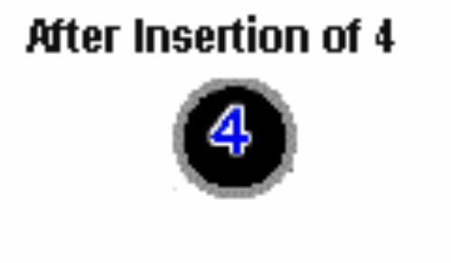
Tree Operations
Inserting a Node: into a tree is actually two separate operations. First, the tree must be searched to determine where the node is to be inserted.
Second, on the completion of the search, the node is inserted into the tree.
Assuming that duplicate entries are not allowed in the tree, two cases must be considered.
Insertion into an empty tree (right). The node inserted is considered the root node.

Slide 5
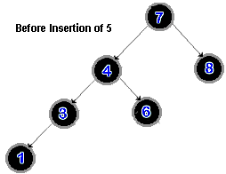
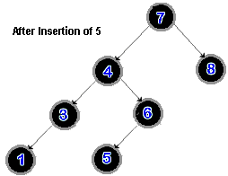
Tree Operations
Inserting into a non-empty tree.
The tree must be searched, to determine where the node is to be inserted. The new node is compared first to the root node of the tree.

Slide 6
Tree Operations
If the value of the new node is less (or equal to) than the value of the root node, the new node is:
  appended as the left leaf of the root node if the left subtree is empty
  else, the search continues down the left subtree.
If the value of the new node is greater than the value of the root node, the new node is:
  appended as the right leaf of the root node if the right subtree is empty
  else, the search process continues down the right subtree.

Slide 7
Tree traversal
Tree-traversal refers to the process of visiting (examining and/or updating) each node in a tree data structure, exactly once, in a systematic way.
Traversals are classified by the order in which the nodes are visited.
3 ways to traverse a tree.
Preorder: visit root, traverse left-subtree, traverse right-subtree.
Inorder: traverse left-subtree, visit root, traverse right-subtree.
Postorder: traverse left-subtree, traverse right-subtree, visit root
Recursive Functions – i.e. all subtrees traversed in the same way.

Slide 8
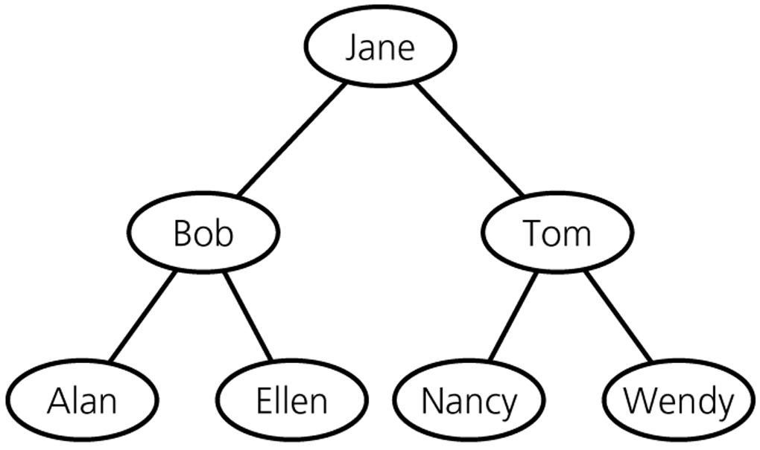
Tree traversal
PreOrder:
Jane, [left], [right]
=Jane,[Bob,Alan,Ellen],[Tom,Nancy,Wendy]
InOrder:
[left],Jane,[right]
=[Alan,Bob,Ellen],Jane,[Nancy,Tom,Wendy]
PostOrder
[left], [right], Jane
=[Alan,Ellen, Bob],[Nancy,Wendy, Tom], Jane
Traversal requires N operations.

Slide 9
General Trees
Binary trees work well for many applications.
But they have problem of bad worst case performance, O(n), e.g. data already ordered, reverse order etc.
General technique called “balancing”, can be used for different “balanced-tree” algorithms.
Implementing balanced-tree algorithms is not easy in general.
General concept is easily described, but implementation is a lot of special and symmetric cases.

Slide 10
m-ary Trees
If we allow each node to have more than 1 key, we can reduce the height of the tree. In an m-ary tree, each node has 0 <= i <= m children.
An m-way search tree
  is empty or
  consists of a root and each node can have at most m child nodes.
This means we can have more nodes for a given height h, than for a binary tree.
Ternary tree – each node can have up to 3 child nodes.
Quadtree – each node can have up to 4 child nodes.

